Slide 1
DIU-AETC
Pilot Training Transformation
APIGEE Overview
The information, scoping, and pricing data in this presentation is for evaluation/discussion purposes only and is non-binding. For reference purposes, Google's standard terms and conditions for professional services are located at: https://cloud.google.com/terms/professional-services.

Slide 2
Agenda
Core Design Principals
Edge API Services
Analytics and Developer Services
Architecture Details
Internal Concepts

Slide 3
High-Level Introduction
Apigee Overview

Slide 4






The Core Design Principle: “API First”
App Consumption
API Exposure
API adaptations needed for apps
Enable developers for business
Security for app-to-API
App and behavior analytics
APIs architected for abstraction
Enable developers for API use
Security for API-to-backend
API Analytics
Analytics
API
API
App
App Server
Services
Notes:
Description of our place based on Ed/Dilshad’s prez
Core concepts of Apigee is API first. Centralized platform that controls access to backend resources. That platform has a couple of “faces” API Exposure layer / façade – talking about SOAP APIs, inconsumable REST APIs. The app consumption façade is what is exposed to developers. The space in between those faces is where you perform transformations, provide for orchestration capabilities, etc.

Slide 5
“API First” Goals
Persistence:
Free, bi-directional exchange of mobile-optimized data, in batch and real-time
Supports rapid evolution of apps
Security:
Unified view of security across both services and persistence layer
Orchestration
Provides a common view on diverse data and services
Analytics
A window into behavior across all channels
Notes:
functionality of the API tier in API First
Same SDK exposes not only data but services as well

Slide 6

API Value Chain – App Developer is the “primary” User / Actor
API First Value Chain
User
App
Developer
API
API Team
Backend
App Developer is the focus audience for APIM

Slide 7
Apigee Edge Primary Services
Developer Services
Developer
Engage internal & external developers and monetize APIs
API Team
Analytics Services
Visibility from the app-end to the back-end
Business
User
API Services
Great apps in minutes
App
Backend
Notes:
Main Points:
Apigee Edge delivers the most comprehensive set of tools to support your Mobile Value Chain.
Script:
API Layer to securely transform backend services to easily consumable APIs to accelerate app development
Developer Layer to enable, engage and transact with your developer community (represented by the gray people graphics)
Data Layer to provide visibility from the app-end to the backend for business and technical teams

Slide 8
Apigee Edge - API Services
Apigee Edge API Services
Protocol Transformation: Enhanced connectivity
Optimization: High performance
Versioning and Enrichment: Management and integration
Security: Protection of key systems
Scripting:
Build or reuse custom logic
Accelerated Development: Mocks for AYTBD components
Notes:
As Yet To Be Developed

Slide 9
End-to-End Benefits
Consumption
Exposure
Flexible application level access control
Security for app-to-API
Application & User level access control
Key Focus on App Developer
Make it easy to use the APIs!
Enable API team to securely access backend services
E2E Security translations for API-to-backend
Secure access to business services
Monitoring & Visibility into backend performance
End-to-End Security, Monitoring, Control
User
App
Developer
API
API Team
Backend
Notes:
Main Points:
The path to securing the Digital World is along the Mobile Value Chain.
Script:
Let’s start with the architecture. A typical API-centric architecture is comprised of two tiers:
The API infrastructure service, or “service exposure,” tier - Composed of API service providers (internal backend services and external partner services); services that securely transform existing backend capabilities into APIs; and new data services that power apps (mobile, social, web, and partner) and are aided by self-service API and management portals.
The API developer service, or “API consumption,” tier - Includes services that enable developers to build and deploy apps in a secure way; engage with a developer community; and help manage application life cycles via self-service API and developer portals.
Why is this view important? One of the key tenets that enable "defense in depth" security practices within an enterprise is “separation of concerns.” This design principle will make it easier to design security into the architecture and facilitate strong security management such as “separation of duties” between the service providers (the IT architect, IT security, and business) and service consumers (developers and end users).
The key benefit of following a separation of concerns principle is that developers can continue to innovate and iterate with an app-centric security model while IT security architects and operations teams can safely expose the APIs without compromising on the enterprise security standards (authentication, authorization, message security, threat mitigation, logging, and auditing).

Slide 10
Protocol Mediation and Mobile Optimization
Transport Protocol
SOAP, REST
JMS
Streaming
Chunked
Full Streaming
Message Protocol
XML
JSON
Cache
Distributed Cache
Response Cache
Distributed Network
Content-Based Routing
Distributed “Smart” Routing
Notes:
Main Points:
Enterprise Security for API has diverse requirements and Apigee edge serves in all those fronts.
Script:
We not only cover runtime API security like threat detections but also
Better authentication and authorization options
Design time access control
Auditing for compliance
Our solution is flexible and highly customizable unlike many appliance style solutions.
Our software stack and cloud infrastructure or process all are regularly audited and certified for PCI , HIPPA or other industry std. compliance.
Apigee Enterprise is meets the critical enterprise security and compliance requirements: PCI-DSS, HIPAA and SOC 2 (in Sep)
Background Info:
PCI: Payment Card Industry Data Security Standard is a set of standards designed to ensure that all companies that process, store and transmit credit card information maintain a secure environment.
HIPAA: Health Insurance Portability and Accountability Act. Establishes national standards for electronic healthcare transactions and national identifiers for providers , health insurance plans and employers.
SOC2 audits security, availability, process integrity, privacy and confidentiality (system accuracy, completion and authorization of operational control systems (IT and data center services providers) against a predefined Trust Services Principles and Criteria. SOC2 audits assures customers that we have adequate control systems in place to safeguard their data and information.

Slide 11

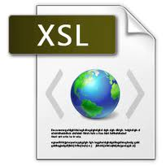
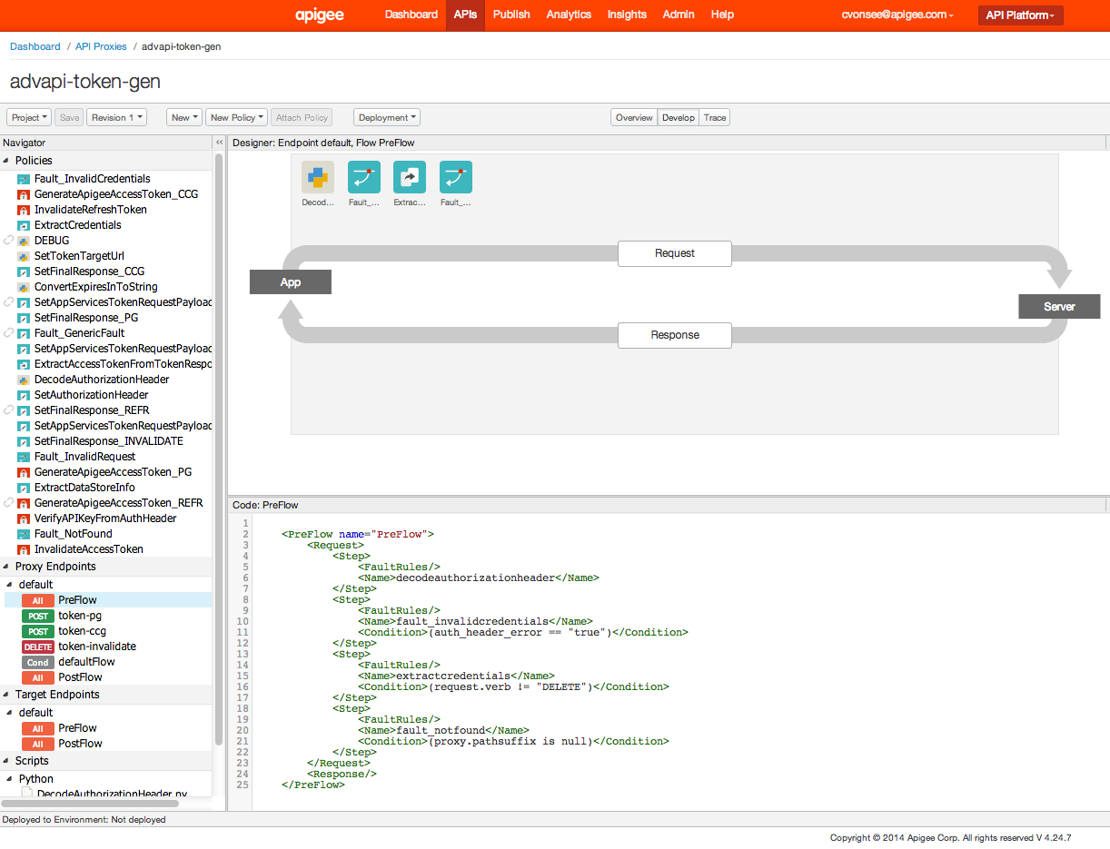

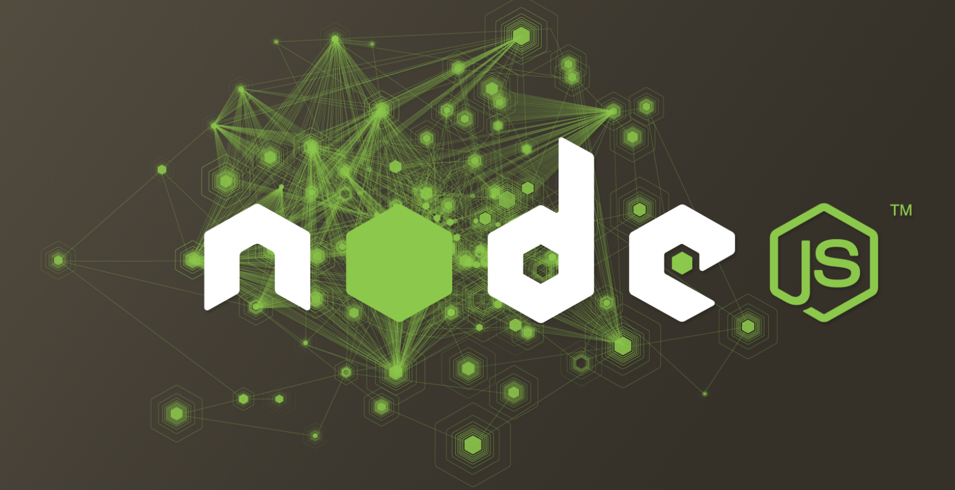
Configuration or Coding… or Both
Notes:
Main Points:
Enterprise Security for API has diverse requirements and Apigee edge serves in all those fronts.
Script:
We not only cover runtime API security like threat detections but also
Better authentication and authorization options
Design time access control
Auditing for compliance
Our solution is flexible and highly customizable unlike many appliance style solutions.
Our software stack and cloud infrastructure or process all are regularly audited and certified for PCI , HIPPA or other industry std. compliance.
Apigee Enterprise is meets the critical enterprise security and compliance requirements: PCI-DSS, HIPAA and SOC 2 (in Sep)
Background Info:
PCI: Payment Card Industry Data Security Standard is a set of standards designed to ensure that all companies that process, store and transmit credit card information maintain a secure environment.
HIPAA: Health Insurance Portability and Accountability Act. Establishes national standards for electronic healthcare transactions and national identifiers for providers , health insurance plans and employers.
SOC2 audits security, availability, process integrity, privacy and confidentiality (system accuracy, completion and authorization of operational control systems (IT and data center services providers) against a predefined Trust Services Principles and Criteria. SOC2 audits assures customers that we have adequate control systems in place to safeguard their data and information.

Slide 12
Apigee Edge – Analytics Services
Apigee Edge Analytics Services
Dashboards: Bird’s eye view on traffic
Custom Reports: Personalized views
Data Export: Share or integrate analytics data
App Analytics: End to end view

Slide 13
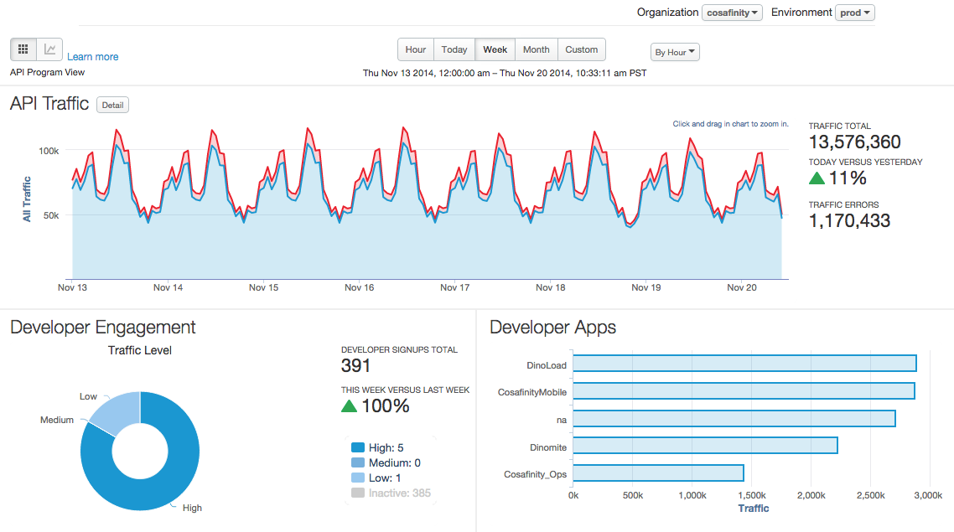
Analytics Services Dashboard

Slide 14
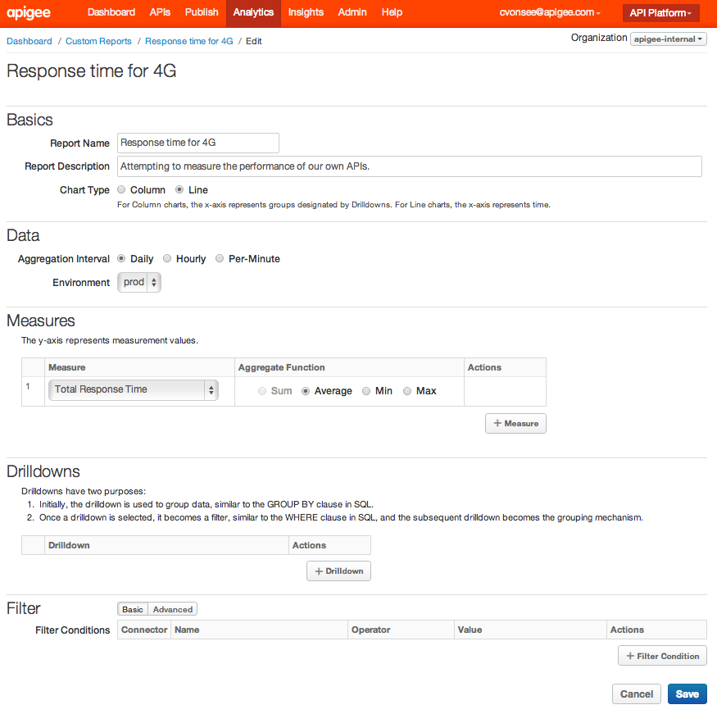
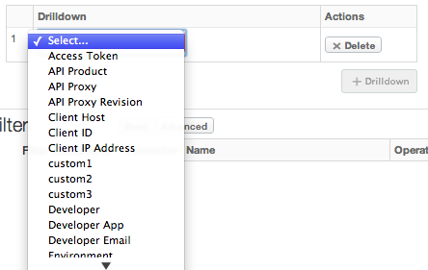
Custom Reporting
Custom reports can show a number of different measures and provide details based on a variety of different drilldown criteria

Slide 15
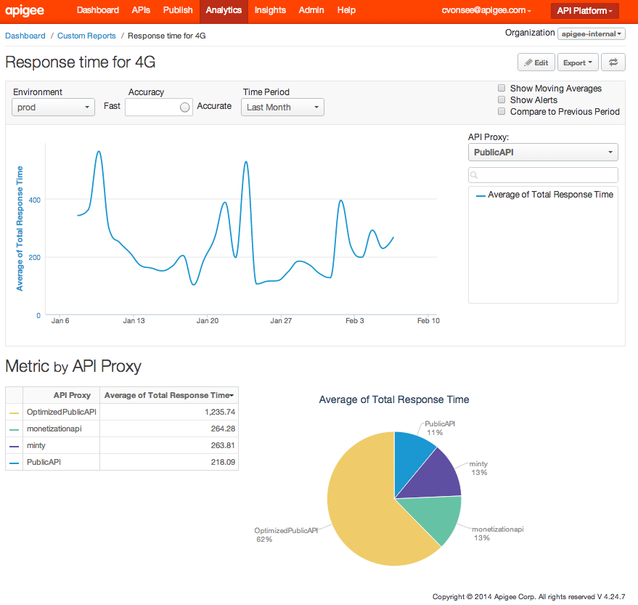
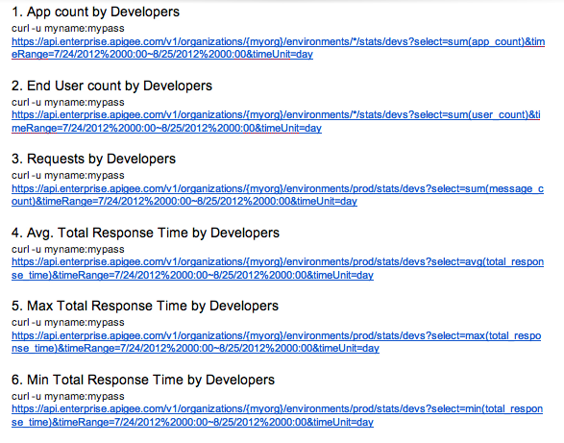
Exporting Statistics

Slide 16
Apigee Edge – Developer Services
Apigee Edge Developer Services
API Modeling: Automated API documentation
Developer Onboarding: Self-service API adoption
Community: Active data sharing and developer engagement
Developer Analytics: provide developer-level visibility
Monetize: Deploy business model for API products

Slide 17
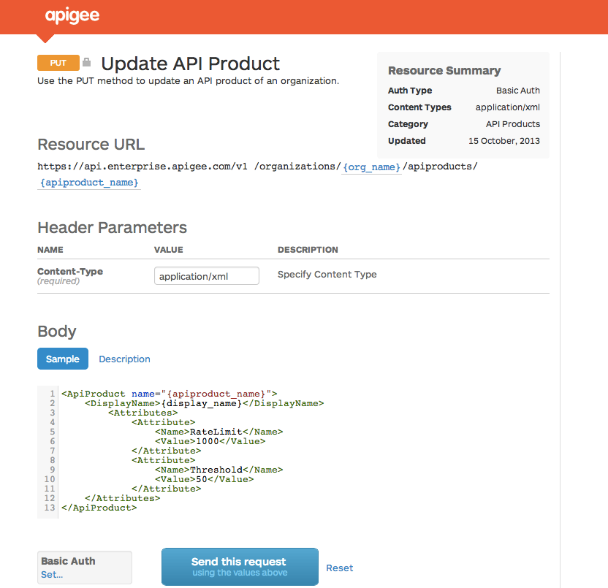




Implement progressive API Modeling and Documents
API-based
Integrate with any portal / CMS
API Modeling
Describe an API structure
OpenAPI
Generate interactive documentation
Apigee Edge Developer Services
Other CMS
gh-pages
Notes:
Main Points:
Edge Developer Services offers great modeling and documentation of API models functionality
Script:
API Modeling is a central service that holds the machine-structure of your API, and it uses that structure to organize all related metadata for your API.
The OpenAPI doc generator takes that model and renders it into detailed API docs that developers need to be successful. Edge API Modeling and OpenAPI docs are progressive – meaning that there is two way interaction between the model and the OpenAPI doc and the API model continues to learn from updates made directly in the OpenAPI doc too.

Slide 18
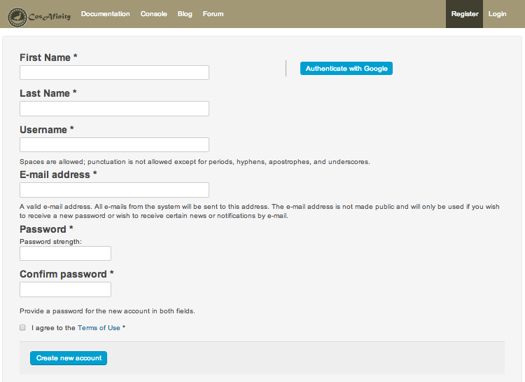
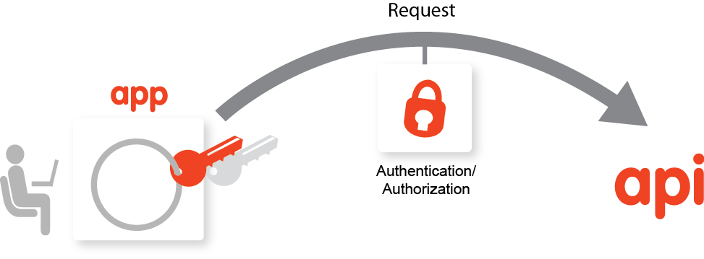
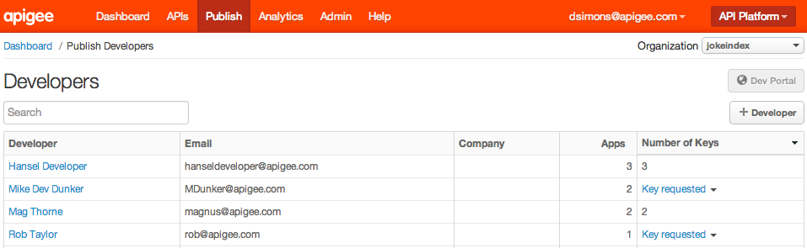
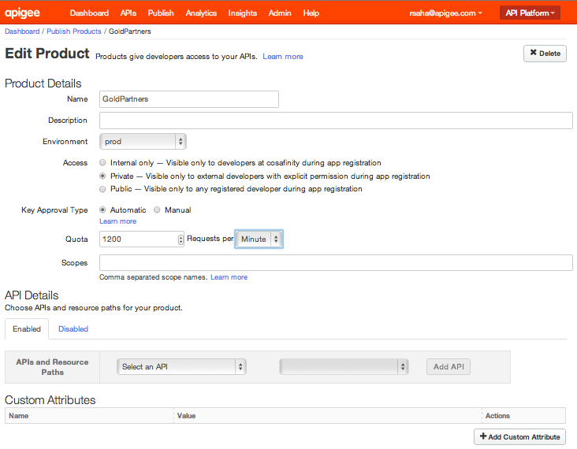
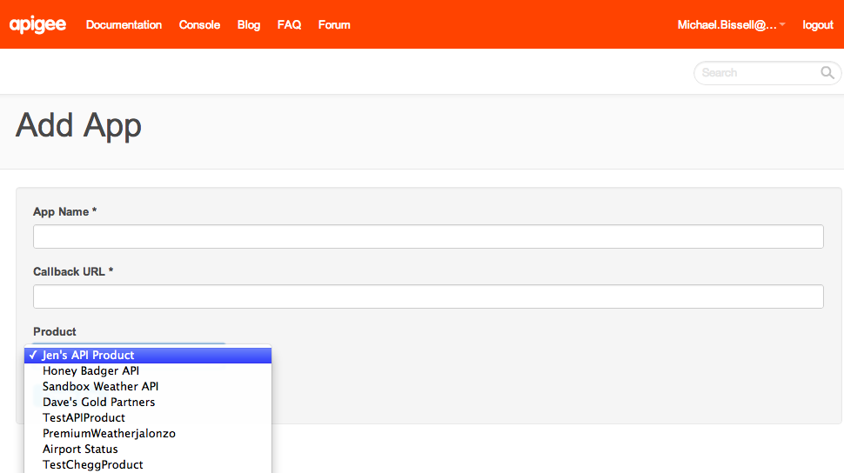
Onboard your developers via self service
Add App
Developer signs up and requests key
Manage key requests
Key approval designation
Developer ready to go
Notes:
Main Points:
Apigee Enterprise is the only truly self-service offering from developer sign up to management of APIs and policies to debugging of the end to end API proxy.
Script:
Whether your API is for internal of external developer consumption, your developers can easily request access keys, your architects can setup the key approval model based on your preferences or easily approve access and the developer is ready to start developing.

Slide 19
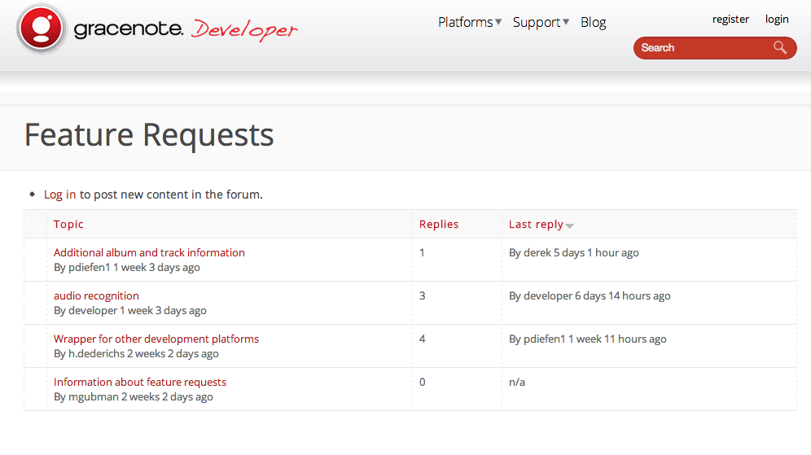

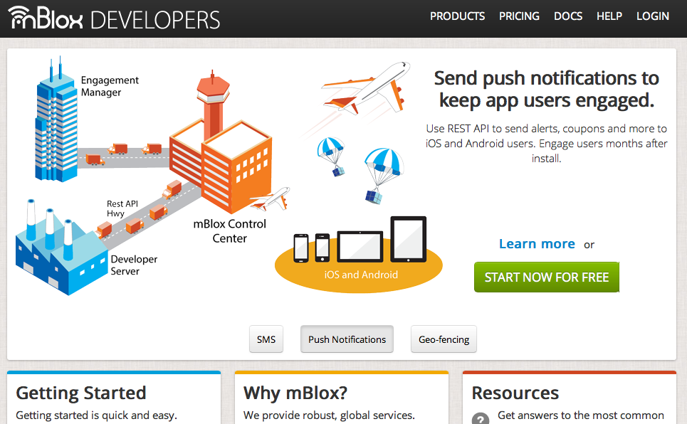
Customize the Developer Experience

Slide 20
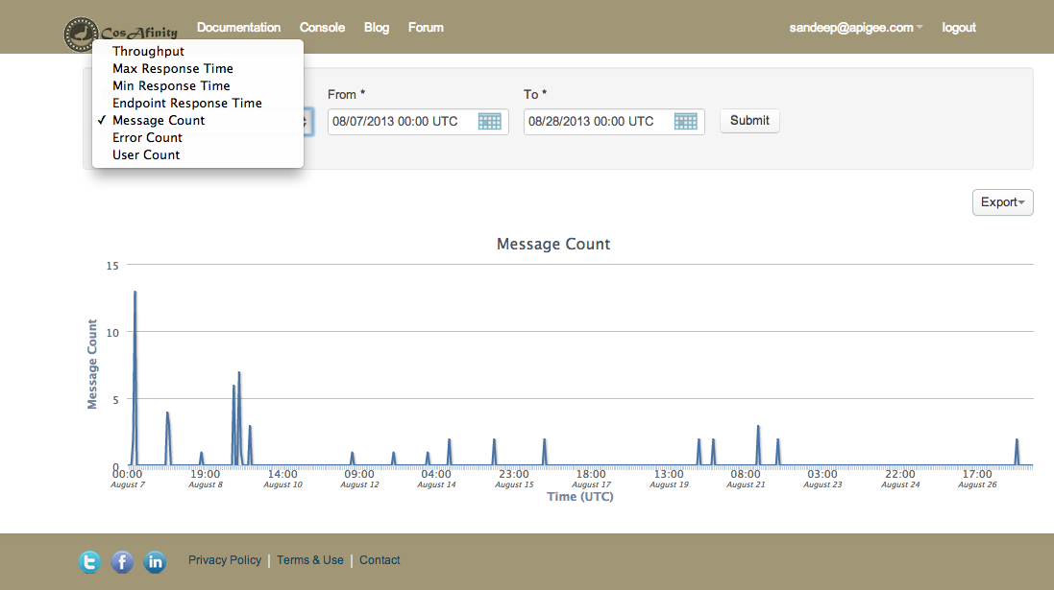
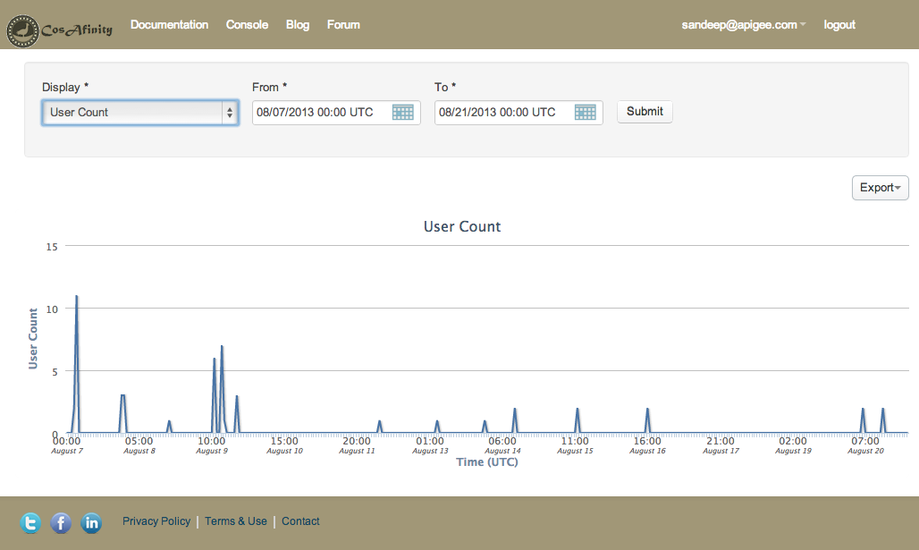
Provide developers with their own analytics
Notes:
Main points:
Apigee Edge not only delivers extensive end-to-end Analytics capabilities for API providers, but it also offers analytics to developers so they can see the results of their work with out of the box charts such as user count, throughput, message count over time through their apps. These reports are available to the developers as they login to the developer portal.

Slide 21
Architectural Details
Apigee Overview

Slide 22
Overview
Apigee Edge comprises of several stateless components that use “Infrastructure Services” to persist data.
Gateway: Router + Message Processor, Nginx
Apigee UI’s: Enterprise UI, BaaS Portal
Infrastructure Services: Cassandra, Zookeeper, LDAP
Analytics Services: PostgreSQL, Apache Qpid, Ingest
Developer Services: Portal, Developer Onboarding & Mgmt
Management Server: Provider of REST APIs for all configuration tasks
API SERVICES
Gateway
Client
Backend
ANALYTICS
SERVICES
Analytics Backend
Infrastructure
Services
BaaS
Backend
BaaS
SERVICES
DEVELOPER
SERVICES
Developer Portal
Management Server
Apigee UIs

Slide 23
Architecture (High level)
Additional scaling and redundancy of Backend Services
Additional gateways can be added easily to follow increased load.
Management Server, Analytics Backend, App Services Backend and Developer Portal can also be configured in a Highly Available scenario.
Gateway
Load Balancer
Gateway
Client
. . .
Backend
Gateway
Analytics Backend
Infrastructure
Services
Services
Backends
Analytics Backend
Infrastructure
Services
App Services
Backend
Infrastructure
Services
Developer Portal
Management Server
Apigee UIs
Developer Portal
Management Server

Slide 24
Architecture (High level)
A DR setup is basically a duplicate setup of Apigee Gateway with Infrastructure Services that replicate their data across data centers
Developer Portal
Management Server
Apigee UIs
Analytics Backend
Infrastructure
Services
BaaS
Backend
Infrastructure
Services
Infrastructure
Services
Gateway
DC-1
Gateway
DATA REPLICATION
Load Balancer
Load Balancer
Client
Gateway
Backends
DC-2
Gateway
Analytics Backend
Infrastructure
Services
BaaS
Backend
Infrastructure
Services
Infrastructure
Services
Developer Portal
Management Server
Apigee UIs

Slide 25
Architecture (Component View)
The four high level blocks consist of several java applications together with storage components (cassandra, mySQL, postgreSQL, ldap) and the distributed configuration manager, zookeeper.
API SERVICES
Router
Message Processor
Client
Backend
openldap
zookeeper
cassandra
qpidd
ANALYTICS
SERVICES
Key:
Edge UI
Management Server
Qpid / Ingest Server
Apigee
3rd party
postgreSQL
Note:
All components of API and Analytics Services also talk to zookeeper
DEVELOPER
SERVICES
Developer Portal
mySQL
Postgres Server
Notes:
----- Meeting Notes (3/29/16 10:50) -----
apacheds

Slide 26




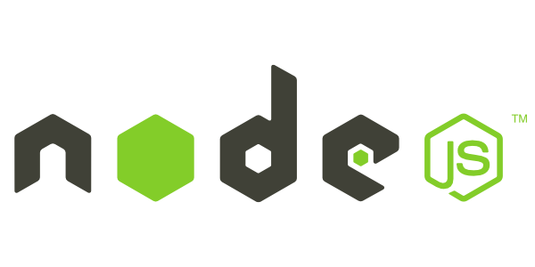




Security Architecture
Identity
User Management
RBAC Management
Policy Management
Certificate Management
Keys/Token Management
Developers
IT Security /Architect
API Security
Authentication
Authorization
Policy Enforcement
Traffic Management
Logging & Auditing
Apps
Key Store
Policy Store
Log Store
Threat Protection
TLS
DDoS
Rate Limiting & Quota
Payload Protection
Analytics
Compliance (SOC 2, PCI DSS, HIPAA) and Cloud Security
Notes:
Script:
So how can an enterprise deliver API-centric security to meet all of their stakeholder needs? The following best practices represent a great start:
Create an API security architecture with both “API consumption” and “service exposure” perspectives and a threat model to support security controls on both tiers. Keep in mind that any API-centric architecture should support separation of concerns from the stakeholder responsibility point of view.
Employ RBAC at every layer to implement “separation of duties” and protect sensitive information, including API keys, SSL certificates, OAuth tokens, and audit logs.
Roll out a developer-centric security service aided by self-service and an API management layer. These services should be capable of configuring an API authentication scheme (OAuth, API key, OpenID, and two-way SSL), token management, policy enforcement, and logging. Note, however, that any coding of security into the application will create new vulnerabilities and long-term risk management challenges for IT security.
Employ fine granular authorization using OAuth, API keys, and RBAC policies to provision the least privileges required by applications to manage the respective concerns.
Protect both the communication and payload using SSL/TLS and threat protection features built into the API management products.
Log relevant data that support security analytics and forensics analysis.
Finally, any API-centric architecture should be capable of evolving with new business and developer requirements and be flexible to meet these without adding new attack surfaces. In other words, it should offer continuous API-centric security.

Slide 27
Delivering a secure App and API infrastructure
API Security
App to API (Consumption)
Authentication (TLS, OAuth, API key)
API key and token management
Two-way TLS
Authorization (permission management)
Runtime policy
SLA enforcement
Logging and auditing
API to Backend (Exposure)
Authentication (TLS, OAuth, SAML)
Two-way TLS
Delegated authentication (LDAP, AD)
Integration with custom identity providers
Fine grain authorization
Logging and auditing
Analytics
Security reports
Run time detection reports (volume based, traffic properties)
Threat Protection
Identity
Infrastructure Security and Compliance
XML/JSON Poisoning/Injection
SQL Injection
DDoS/App-DoS Attacks
Quota/Spike Arrest
IP based access restrictions
User provisioning
RBAC management
Groups
Identity provider
Cloud or on-premise
Cloud-based security (AWS + other)
SOC 2, PCI-DSS, HIPAA
24 x 7 organizational support
Notes:
Main Points:
This slide build on the slide which states “The path to securing the Digital World is along the Mobile Value Chain”.
Apigee Edge provides a holistic approach to app and API security. It is designed from the ground-up to deliver on your digital business cases. Items shown in orange are the main security pillars within Apigee Edge. Again think “defense in depth” and “separation of concerns”.
Script:
Apigee Edge via API Services provides an end-to-end security approach to a customer’s business cases. Our solution is enabled via configuration (e.g. TLS, OAuth, Policy based access control, rate limiting). Security is integrated into our product at all levels (access control, separation of duties, logging, auditing). It is not a bolt on, or a separate concern and exists regardless of deployment.
Apigee’s “Security Pillars” address API Security, Threat Protection, Identity Management and Apigee’s Infrastructure and Compliance capabilities. The pillar premise follows on from the “defense in depth” and “separation of concerns”.
Additional points to discuss:
Our solution is flexible and highly customizable unlike many appliance style solutions.
Our software stack and cloud infrastructure or process all are regularly audited and certified for PCI , HIPPA or other industry std. compliance.
Apigee Edge meets the critical enterprise security and compliance requirements: PCI-DSS, HIPAA and SOC2 (in Sep)
An important point to bring up is the difference between "network-based" attacks and ”API-based" attacks. When we talk about end-to-end security that’s in the context of APIs. As discussed earlier one of the key tenets that enable "defense in depth" security practices within an enterprise is “separation of concerns.” This design principle will make it easier to design security into the architecture and facilitate strong security management. Separation of duties applies not only to exposure and consumption but also between aspects such as network and API security. This implies that network layer attacks should still be prevented using the appropriate tools. API platform tools should focus on API and app level attacks which is what Apigee does well!
Another point to consider is different attacks occur when building a web app, or exposing a WCF service versus building APIs. End-to-end API security is utilized in the context of real business use cases. Features and capabilities are important in the context of actually solving these use cases. Apigee is built from the ground-up for developing secure, functional and performant business solutions.
Background Info:
PCI: Payment Card Industry Data Security Standard is a set of standards designed to ensure that all companies that process, store and transmit credit card information maintain a secure environment.
HIPAA: Health Insurance Portability and Accountability Act. Establishes national standards for electronic healthcare transactions and national identifiers for providers , health insurance plans and employers.
SOC2 audits security, availability, process integrity, privacy and confidentiality (system accuracy, completion and authorization of operational control systems (IT and data center services providers) against a predefined Trust Services Principles and Criteria. SOC2 audits assures customers that we have adequate control systems in place to safeguard their data and information.

Slide 28
Concepts
Apigee Overview

Slide 29










Apigee concepts in a nutshell
Apigee
Apigee Edge
Organization
Mobile
Point of Sale
ESB, SOA,
App Servers,
Databases
Developers
Applications
API Team
Environment
Partner
Environment
Web
Environment

Slide 30







API Proxies and Policies
Environment
Proxy
ESB, SOA,
App Servers,
Databases
Policy
Policy
Policy
Applications
Caches
Key-Value Storage
Backend- as-a- Service
Analytics

Slide 31
Key Terms
An Organization is a collection of users, APIs and other resources
An Environment is a subset of APIs in an Organization that are in a given deployment state
Default Environments: Test and Prod
An API Proxy is a set of configurable logic that handles API requests.
Flows represent a specific request type within an API proxy
Usually qualified by verb and path, but often by other request parameters as well
Pre / Post / Conditional (also referred to as resources [as in URL])
Policies (also known as Flow Steps) are bits of logic that can be executed during the course of processing a request
Policies can be applied to all Resources in a Proxy or only to select Resources
Policies can be conditionally executed
Notes:
----- Meeting Notes (2/9/16 10:30) -----
Change Resoures to flows in last point.

Slide 32
Developers and Apps
Developers are the internal or external partners that create applications that use your API products
Developers can be internal or external, and generally represent individuals
Developers can be grouped into Companies
Developers are associated with Applications, which are developer-written programs that use APIs
Applications can also be included in Companies
Applications (and Flows) can be grouped into Products for exposure to Application Developers
Application Users are restricted by Product definitions

Slide 33
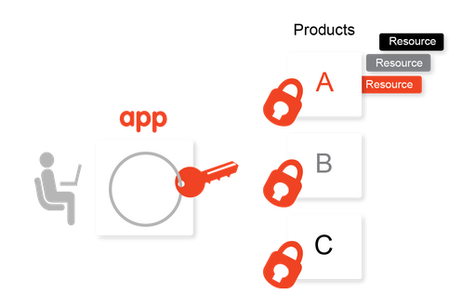
API Security
Keys are:
assigned to an application when it is created
linked to a Product when the Product is associated with an application
API Products are:
collections of API resources, combined with a service plan and presented to developers as a bundle.
the central mechanism for authorization and access control.

Slide 34
Security for Apigee Edge Users
Permissions define create/read/update/delete access to resources
Roles identify a collection of permissions that can be assigned to a user
Predefined roles assign common permissions to key Apigee resources
Organization Administrator
Administrator of an organization
Business User
API program manager
Responsible for success of API Program and developer management, KPIs
Operations Administrator
API Operation Manager
Responsible for production and test deployment, troubleshooting
User
API Developer
Responsible for mainly user management but has super access to everything
Responsible for development of API proxy, Policy management, troubleshooting etc.

Slide 35
API Proxy and Target Endpoints
Define an API as a set of resources that access a given target system.
Client-side interfaces can be accessed using either HTTP or HTTPS
Targets can be accessed using either HTTP or HTTPS, using either one-way SSL or two-way SSL with mutual authentication
REST and SOAP (via translation) targets supported
“First match” selection: define a set of resource criteria matching incoming requests, and the first match found controls request execution
Resource matching on path nodes, query parameters, HTTP verbs and other types of conditions
Determine target service for requests using either static or dynamic routing

Slide 36
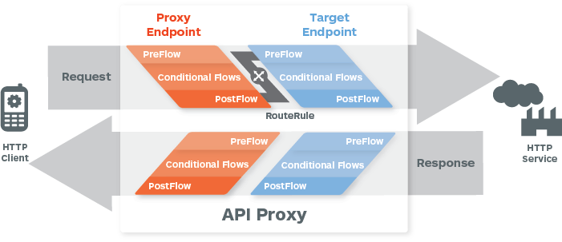
API Proxy Flows
Flows allow you to define API resources.
Conditionally execute policies across all flows (resources) or only for specific resources.
Add policies that execute either before or after backend API request.

Slide 37
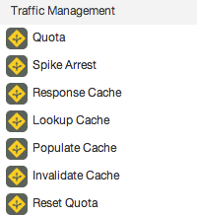
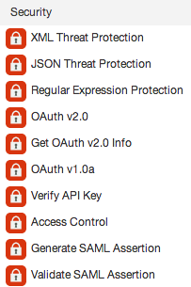
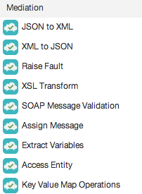
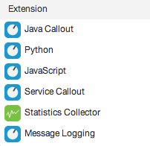
The power of policies
Manage interactions with API consumers and optimize performance
Secure APIs and protect back-end systems from attack
Transform, translate and reformat data for easy consumption
Extend with programming when you need it
Notes:
Those rules of engagement come in the form of easy-to-configure policies and strong scripting capabilities that

Slide 38
The “processing pipeline” is powerful and flexible
API Services
App
Backend
Enforce security
Validate request
Transform parameters and payload
Translate between developer-friendly APIs and back-end systems
Build orchestration and optimization via node.js
Notes:
Apigee’s runtime processing capabilities are enforced through two means: configurable policies and flexible scripting. These two things can be combined into a processing pipeline that enables both enforcement of the runtime rules of engagement with the API and the transformations required to get from the clean REST API to the interface exposed by the back end system.

Slide 39
Variables and Conditions
Variables allow you to store data for use during policy execution
Apigee Edge provides an extensive set of pre-defined variables covering areas such as:
System (date/time, host name, etc.)
Configuration (organization/environment/application name, proxy base path, etc.)
Request and response (client IP address, query and form parameters, headers, request body, target host name, timing data, etc.)
Policy (variables specific to the individual policy, such as rate limit info)
OAuth 1.0a and 2.0 (information related to access tokens, etc.)
Create your own using the Assign Message policy or from JavaScript/Java
Conditions allow you to control when a policy gets executed and which resource definitions are selected for processing
Compare path nodes, HTTP verbs, headers, query parameters, form parameters or variables with each other

Slide 40
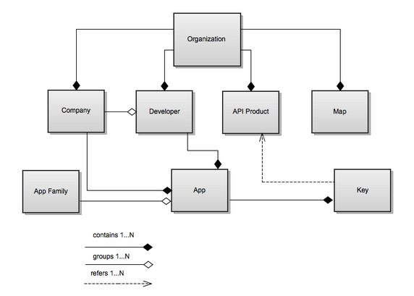
Controlling Apigee Edge using Mgmt APIs
Create, manage and delete just about anything:
API proxies
Policies
Developers and companies
Apps, app families and app keys
API products
Environments
Export and import entities
Manage users within organizations

Slide 41
Controlling Apigee Edge using Mgmt APIs
Create, approve, delete, approve and revoke OAuth authorization codes, access tokens and refresh tokens
Retrieve statistics for environments, APIs, apps, developers, etc.
By default, you can retrieve stats on response times, response status codes, request/response sizes, request/response latency, and other dimensions
Custom analytics policies allow you to gather and report on data from request paths, query params, headers or payloads
Start debug sessions and retrieve information

Slide 42
API Design Goals
Determine the best organization and environment configuration for your needs, and establish connectivity for API-consuming applications, Apigee and target endpoints, and URI Pathing strategy
Create API design, testing, access control and source code management guidelines
Design, implement and document your APIs using modeling, policies, Node.js, security, etc.
Produce general guidelines for packaging your APIs for developer consumption (Productization), and grant developers' access via API key assignments
Design and implement mechanisms for registering/approving developers, providing access to documentation and other resources, etc.
Develop a testing strategy that verifies the functionality, performance and load-bearing capacity of your APIs, organizations and environments
Automate the deployment of your APIs from dev through production
Monitor the adoption and operation of your APIs
Establish a feedback loop for corrections, improvements, etc.
Notes:
Determine the best organization and environment configuration for your needs, and establish connectivity for API-consuming applications, Apigee and target endpoints, and URI Pathing strategy
Identify the members of the API team that need Apigee access
Design and implement mechanisms for registering/approving developers, providing access to documentation and other resources, etc.
Produce general guidelines for packaging your APIs for developer consumption (Productization)
Identify and deploy API management and monitoring strategies
Create API design, testing, access control and source code management guidelines
Design, implement and document your APIs using policies, Node.js, security, API BaaS, etc.
Implement tests that verify the functionality, performance and load-bearing capacity of your APIs, organizations and environments
Deploy your APIs into production, and grant developers access via API keys
Monitor the adoption and operation of your APIs

Slide 43
Want more information?
http://www.apigee.com/docs/

Slide 44

Questions?

Slide 45
Appendix

Slide 46
Please keep in mind that everything discussed should not be shared outside of this organization and limited for those who have a need to know.

Slide 47
Module Topics
High-Level Apigee Introduction
Core Design Principals
Apigee Edge API Services
Analytics and Developer Services
Apigee Edge Concepts
Organizations and Environments
Developers, Apps, API Products
API Proxies
Flows, Conditions, Variables
Architectural Details
Apigee Components
Security Architecture

Slide 48
[Title]

Slide 49
API Value Chain
API First Value Chain
User
App
Developer
API
API Team
Backend

Slide 50
Node.js for building new APIs
Build highly-customized standalone APIs by leveraging Apigee’s integrated node.js as your back-end system
Solve complex orchestration or mobile optimization problems by combining Apigee policies with the power of a scriptable target endpoint
Use many of the thousands of third-party node.js modules in your APIs without modification
Leverage Apigee’s world-class cloud operations
Notes:
Node.js and the idea of scriptable targets support enables a new level of API customization.
One great use case for scriptable targets is what’s called an “OAuth consent application”. You may already know that in three-legged OAuth there’s a concept of an “authentication server” that is used to verify user credentials and to ask for and record the user permission to share their information with an application. Many of our customers ask us to host this application within Apigee because they don’t have an outboard server that has this capability; with node.js you now have the ability to host this sort of application within Apigee, which simplifies your API authorization and authentication flows considerably.
In general, node.js support can help eliminate the need for separate node.js servers – you can now host those apps in the scalable Apigee cloud.
Node.js gives you the ability to orchestrate calls, perform complex transformations, and do almost anything a regular node.js app can do, but now you can combine that with Apigee policies for even more flexibility.
The really great thing is that you can also use many of the thousands of existing Node.js modules.

Slide 51
End-to-End Security
Consumption
Exposure
Flexible application level access control
Security for app-to-API
Enable API team to securely access backend services
Security for API-to-backend
End-to-End Security
User
App
Developer
API
API Team
Backend
Notes:
Main Points:
The path to securing the Digital World is along the Mobile Value Chain.
Script:
Let’s start with the architecture. A typical API-centric architecture is comprised of two tiers:
The API infrastructure service, or “service exposure,” tier - Composed of API service providers (internal backend services and external partner services); services that securely transform existing backend capabilities into APIs; and new data services that power apps (mobile, social, web, and partner) and are aided by self-service API and management portals.
The API developer service, or “API consumption,” tier - Includes services that enable developers to build and deploy apps in a secure way; engage with a developer community; and help manage application life cycles via self-service API and developer portals.
Why is this view important? One of the key tenets that enable "defense in depth" security practices within an enterprise is “separation of concerns.” This design principle will make it easier to design security into the architecture and facilitate strong security management such as “separation of duties” between the service providers (the IT architect, IT security, and business) and service consumers (developers and end users).
The key benefit of following a separation of concerns principle is that developers can continue to innovate and iterate with an app-centric security model while IT security architects and operations teams can safely expose the APIs without compromising on the enterprise security standards (authentication, authorization, message security, threat mitigation, logging, and auditing).

